Slide 1

Summary of Superstore data
By keshav kumar

Slide 2
With growing demands and cut-throat competitions in the market, a Superstore Giant is seeking your knowledge in understanding what works best for them. They would like to understand which products, regions, categories and customer segments they should target or avoid.
Create visualizations that convey a compelling story.

Slide 3
Metadata
Row ID => Unique ID for each row. Order ID => Unique Order ID for each Customer. Order Date => Order Date of the product. Ship Date => Shipping Date of the Product. Ship Mode=> Shipping Mode specified by the Customer. Customer ID => Unique ID to identify each Customer. Customer Name => Name of the Customer. Segment => The segment where the Customer belongs. Country => Country of residence of the Customer. City => City of residence of of the Customer. State => State of residence of the Customer. Postal Code => Postal Code of every Customer.

Slide 4
Metadata
Region => Region where the Customer belong. Product ID => Unique ID of the Product. Category => Category of the product ordered. Sub-Category => Sub-Category of the product ordered. Product Name => Name of the Product Sales => Sales of the Product. Quantity => Quantity of the Product. Discount => Discount provided. Profit => Profit/Loss incurred.

Slide 5
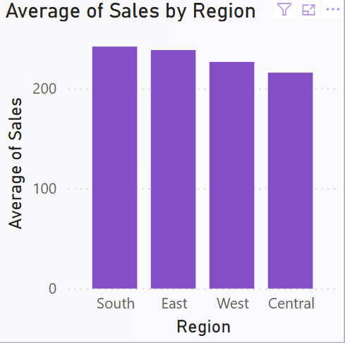
Visualization Analysis
Insights:
Regional Performance Gap: There is a noticeable, though not drastic, difference in average sales among the regions.
Targeted Strategy Needed: The Central region might need focused strategies (e.g., marketing campaigns, pricing strategies, product adjustments) to improve sales performance.
Leverage High Performers: Best practices from the South and East regions could be analyzed and implemented in West and Central.

Slide 6
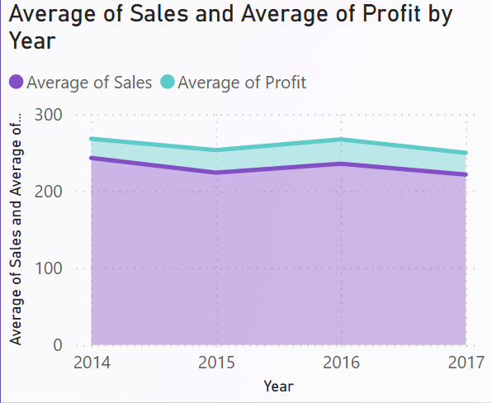
Visualization Analysis
Insights:
2015 Dip: Both sales and profit experienced their lowest average in 2015, suggesting a business challenge that year.
Strong Recovery in 2016:
Both metrics increased, indicating a possible strategic correction or market recovery.
2017 Decline:
A minor dip again, which may require investigation into market trends or company-specific issues.
Trend Consistency:
Sales and profit are closely aligned in movement, meaning profitability is proportionate to sales performance over time.

Slide 7
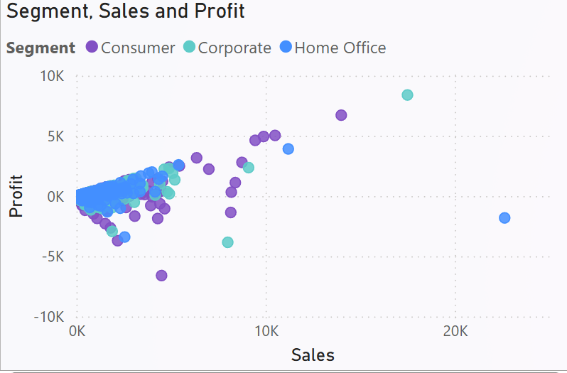
Visualization Analysis
Insights:
Positive Correlation:
There’s a visible positive trend: As sales increase, profits tend to rise for many data points across all segments.
However, the relationship is not perfectly linear—some high-sales points still result in low or even negative profits.
Profit Outliers:
A few Consumer and Corporate segment orders yield very high profits (>5K).
A few data points, especially from the Consumer and Home Office segments, show high losses (< -5K), despite significant sales.

Slide 8
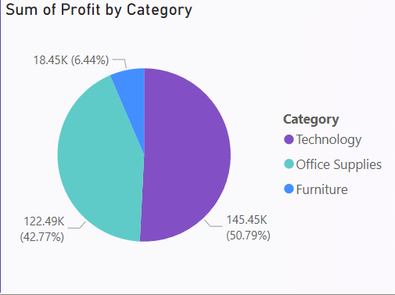
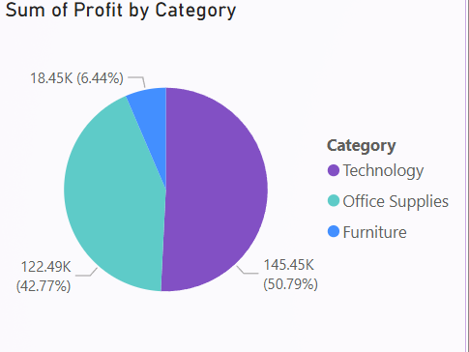
Visualization Analysis
.
Technology is the key driver of profitability – leverage it for promotions, loyalty programs, and market expansion.
🧐 Furniture requires attention – either optimize or minimize investment.
💡 A balanced strategy can be adopted where Office Supplies act as a stable middle ground for consistent profits
Focus growth efforts on Technology due to its dominant profit contribution.
Explore opportunities to grow Office Supplies through bundling or expanding offerings.
Audit the Furniture category to address its weak performance — possibly phase out underperforming items or refresh the line.

Slide 9
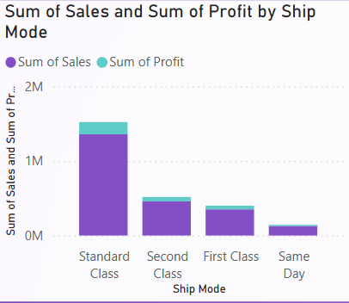
Visualization Analysis
Continue prioritizing Standard Class as the default shipping mode—it delivers the highest value.
Evaluate the cost structure of First Class and Same Day modes—can profitability be improved?
Promote Second Class as an efficient alternative for mid-tier customers.
Consider limiting or restructuring Same Day delivery unless there's a specific strategic reason to keep

Slide 10
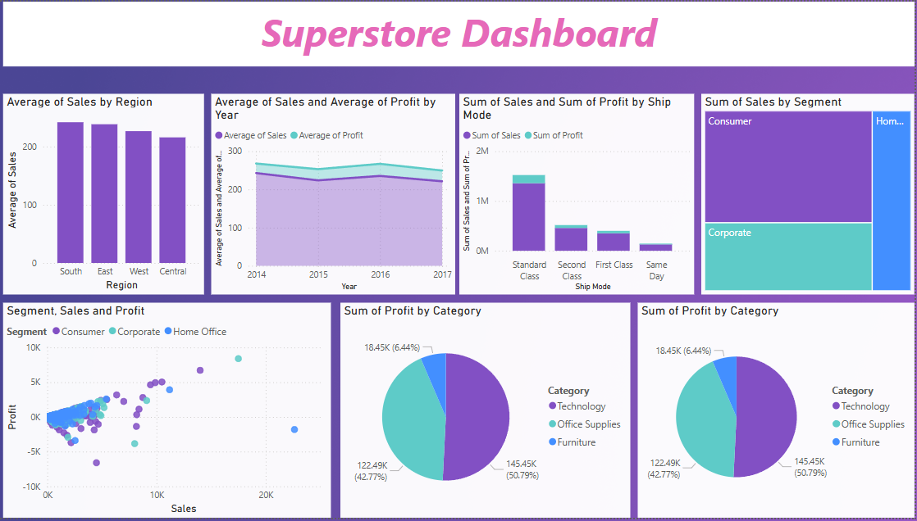
Final Dashboard

Slide 11
Conclusion
The analysis reveals that the Technology category is the most profitable, contributing over 50% of total profit, followed by Office Supplies at 43%. Furniture lags behind with just 6%, suggesting low margins or high costs. Among shipping modes, Standard Class generates the highest sales and profit, indicating customer preference and operational efficiency. Same Day shipping contributes the least, likely due to high costs. The business should focus on promoting high-margin categories like Technology and optimizing shipping strategies, especially by prioritizing Standard Class. Improving or re-evaluating low-performing segments could significantly boost overall profitability and customer satisfaction.

